Slide 1
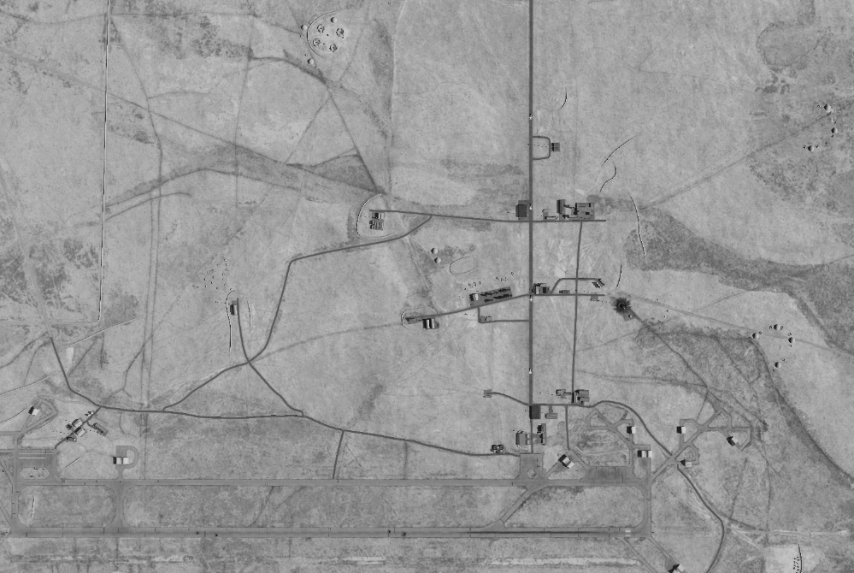
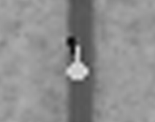
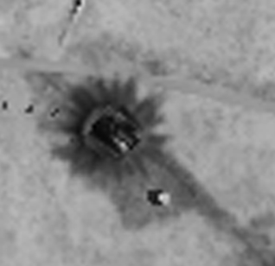
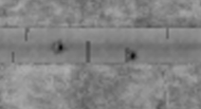

SYTGT040 TABQA AIRFIELD / SYTGT068 SCC EAST / IMAGRY D8
N
ASSESSMENT:
LIKELY 4x MiG-25 UNDER TOWING
ASSESSMENT:
SCC EAST HIGHLY LIKELY DESTROYED
ASSESSMENT:
HIGHLY LIKELY STILL 4 x CRATERS IN RUNWAY

